Slide 1
Software Engineering
Configuration Management with Git
Version 2.0
© Maurizio Morisio, Luca Ardito, 2024

Slide 2
Configuration Management

Slide 3
Main Phases
Development
deployment
Operation
retirement
Maintenance
t

Slide 4
Development
Requirements
definition
Req. inspection
Requirement document
Design
Des. inspection
Design document
Implemen
tation
Code inspection + test
Code
Project management
Configuration management
t

Slide 5
Motivation
Many persons need to work on the same documents
Remember: software made of requirements, design, code, user manual, data,..
for a long period of time
development, operation and maintenance
Where are the documents?
Who can change what, when?
Concurrent access and modification of documents
Who did modify what?
Which was the last working version?

Slide 6
Motivation - 2
Documents have dependencies, in most cases dependencies are not formalized
Ex of formal dependency: ‘import’ class or package in java
Ex of non formal dependency: requirement document vs design document vs code vs test cases

Slide 7
Dependencies
Requirement
Design Item
Code
Fragment
Use case
Test
case
Test result

Slide 8
CM Concepts
Configuration Item (CI)
Unit under configuration management
Can be composed of one (ex requirement document) or more files (C++ class in two files)
Configuration
Set of CIs
Can be consistent CIs (Cis where all dependencies are correct) or not
Repository
Logical / physical place where CIs are

Slide 9
CM Concepts
Versioning
Capability of storing / rebuilding all past versions of a CI or configuration
Change control
Capability of granting right of reading / writing a CI to a defined user

Slide 10
CM concepts
Check-in Check-out
Formal operations made by a user to notify the CMS that a CI is being accessed and modified
Checkout: notification that a CIs is being accessed by a certain user
Checkin: notification that a CIs is no longer accessed, and has been modified
(‘check in’ also called ‘commit’)

Slide 11
Check out
workspace2
Check in
repository
Check out
workspace1
Check in

Slide 12
CM Concepts
Change control models
Lock modify unlock: the first user locks the CIs, no other user can access it until first user unlocks
PRO: no concurrent modifications
CON: obliges to serialize work, first user often forgets to unlock
Copy modify merge: many users can checkout in parallel and work on copies
PRO: allows parallel work
CON: conflicts (== inconsistent modifications of the same CI by different users) are possible, merge operation is delicate, time consuming and possibly error prone

Slide 13
CM choices
What becomes a CI
Not all documents / files in a project become CI
A CI has advantages (versioning access control etc) but at a cost of an overhead (check in check out)
Lock model or not
Time distance between commits
Every week? day? hour?
CM manager role
Defined or not
CMS tool

Slide 14
Configuration Management System (CMS)
Software application capable of
Storing and versioning CIs
Storing and versioning configurations
Change control

Slide 15
CMS Functionalities
Revert CI back to a previous version
Revert configuration back to a previous version
Compare changes over time
Control access (who can read / write what Cis)
Track who modified what when

Slide 16
Where are the documents?
→ repository, CIs, configurations
Who can change what, when?
→ change control
Who did modify what?
→ tracking
Which was the last working version?
→ configurations, versioning

Slide 17
CMS Taxonomy
workspace2
repository
workspace1
Local CMS
Only one machine, repository and workspace on the same machine
Centralized CMS
Server contains repository (all CIs all versions), clients contain copy
Distributed CMS
Server contains repository, each client mirrors the repository locally

Slide 18
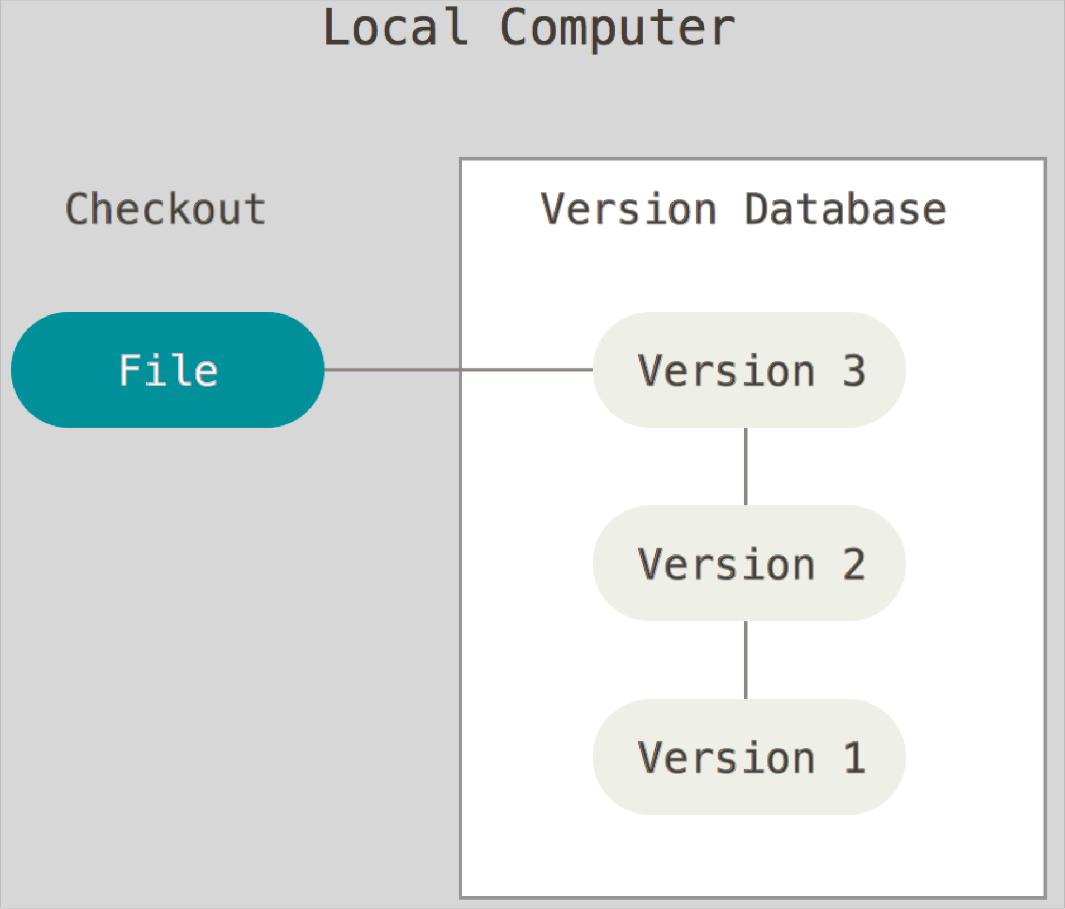
Local CMS

Slide 19
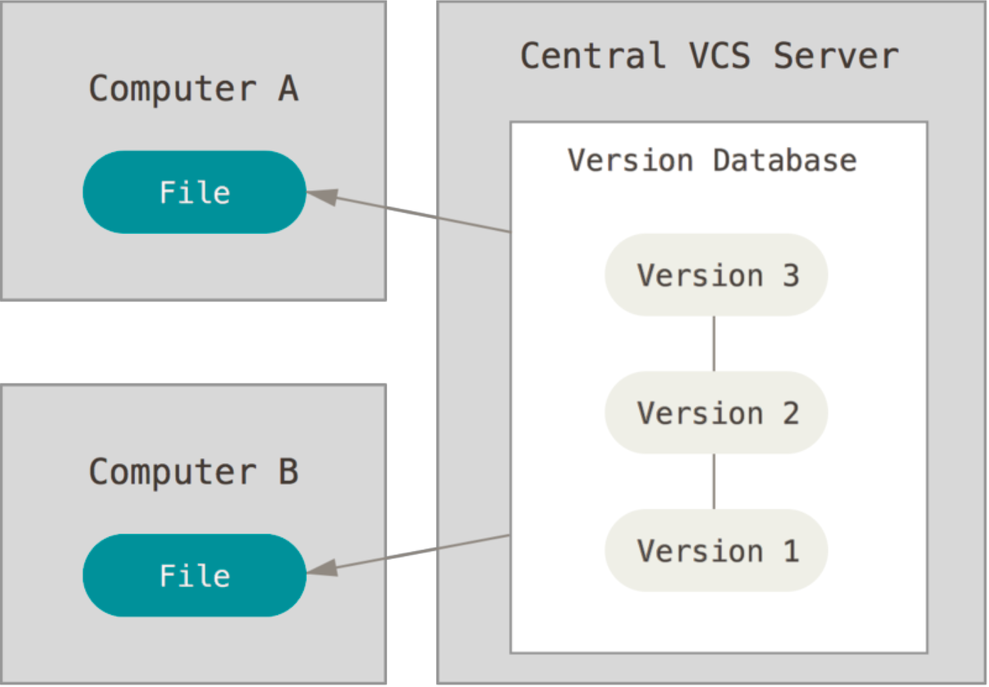
Centralized CMS

Slide 20
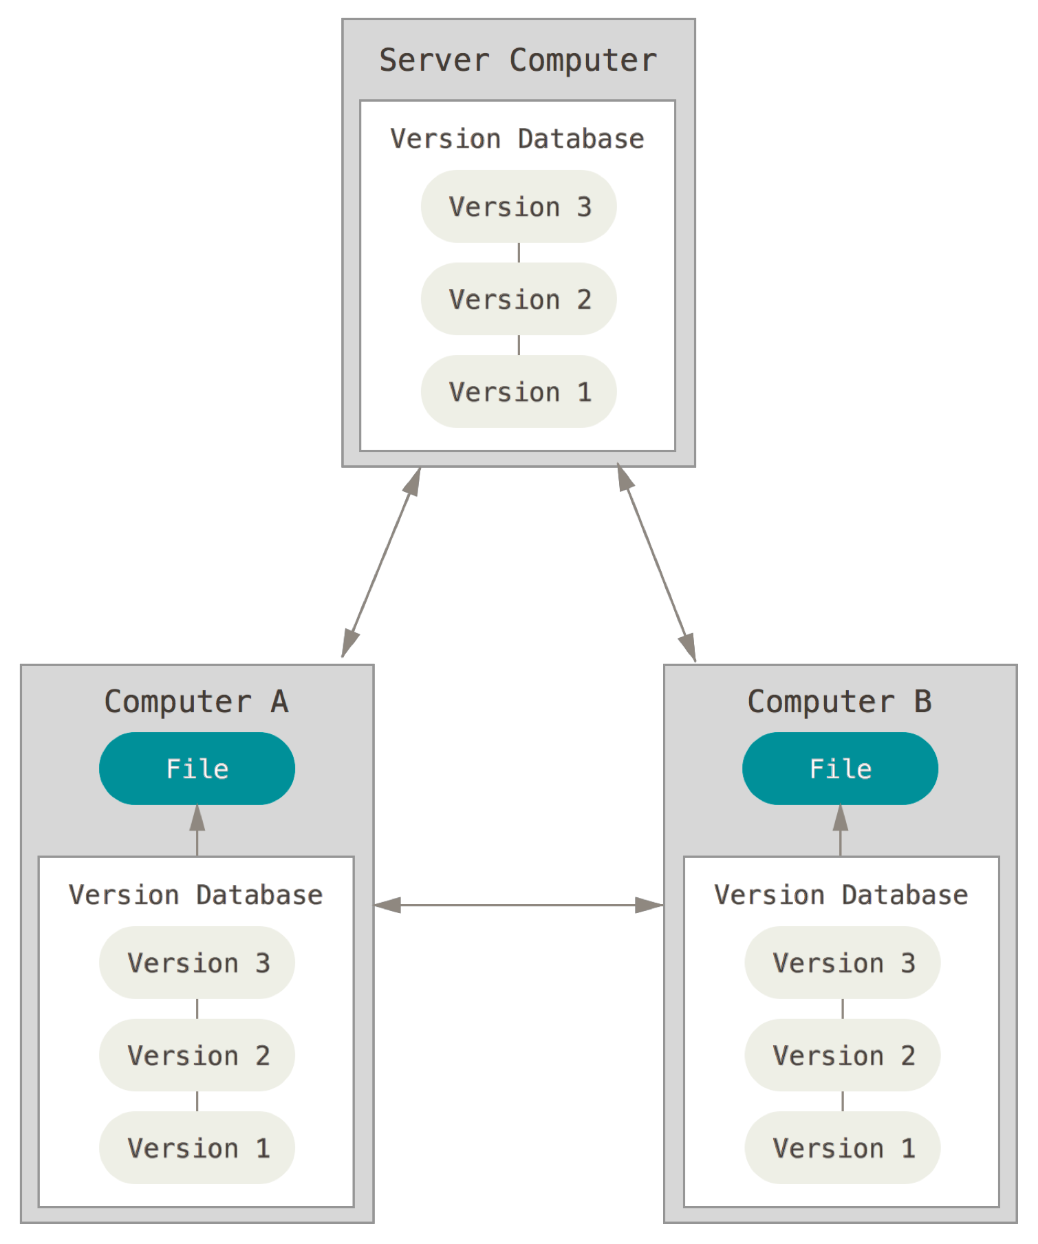
Distributed CMS

Slide 21
Examples
Local CMS
RCS
Centralized CMS
CVS
Subversion
Perforce
Distributed CMS
Git
Mercurial
Bazaar or Darcs
Local only CMS quite obsolete
Distributed CMS are becoming mainstream due to their flexibility

Slide 22
Storage Models
Deltas
For a CI the root version is stored, for next versions only the differences are stored
PRO. Less space is used
CON. Reconstructing a version can take time
Full copies
For a CI a full copy of each version is stored
PRO. More space is used
CON. Each version available in time zero
Full copies more popular since the cost of storage is decreasing

Slide 23
Configuration management models
Differences (ex svn)
A commit by a user changes the version of a CI (only)
Snapshot (ex git)
A commit by a user defines a new snapshot, including all CIs
A snapshot is made of all Cis in the project
If a CI did not change version, a link to the previous one is used

Slide 24
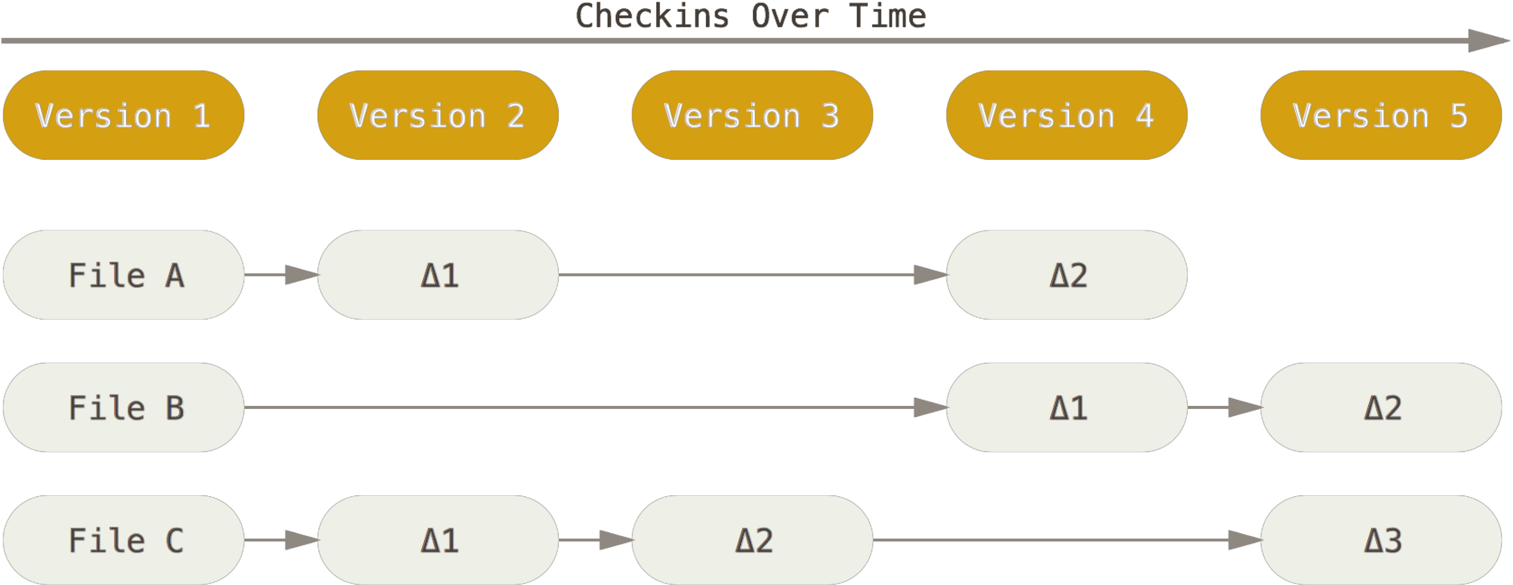
Differences

Slide 25
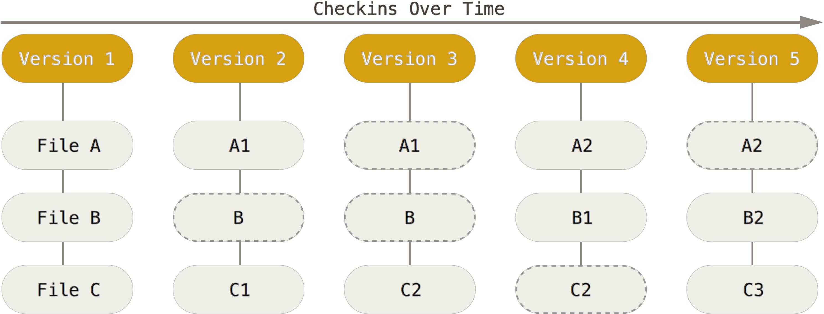
Snapshots

Slide 26
Introduction to Git

Slide 27
Git
Started by Linus Torvalds in 2005 to support Linux development
Radically different from previous CMSs
Focus on
Speed
Support for large projects, with thousand of branches
Support for distributed, non linear development model

Slide 28
Git
Distributed CMS
Snapshots as configuration model
All files together, not one by one
Local operations
No information is needed from other computer(s) (server or else) → speed
Integrity
Everything is check-summed before it is stored and is referred to by that checksum → any change is recognized, no untracked change of any file or directory
Additive
Information is added, never deleted → No worry about messing up things

Slide 29






GitHub
Online code hosting service built on top of git
Mainly used by OSS projects
Commercial use is growing
Used by

Slide 30





GitLab
Another Online code hosting service built on top of git

Slide 31
Basics
Working copy (WC)
Local repository
Remote repository
Client B
Local repo B
WC
B
Client A
Remote repo
WC A
Local repo A
add
commit
push
working directory
rm
fetch
pull

Slide 32
Client side
Folder and file system, or working directory or working tree
Files and folders
Working copy (WC), or index, or staging area
Files and folders to be committed, but not yet versioned
Add: enters a file from file system into working copy
Rm: removes file from working copy
Local repository
Files and folders, versioned
Commit: enters all files (snapshot) from WC to local repository
Fetch, rebase: copies snapshot from local repository to WC, merge them

Slide 33
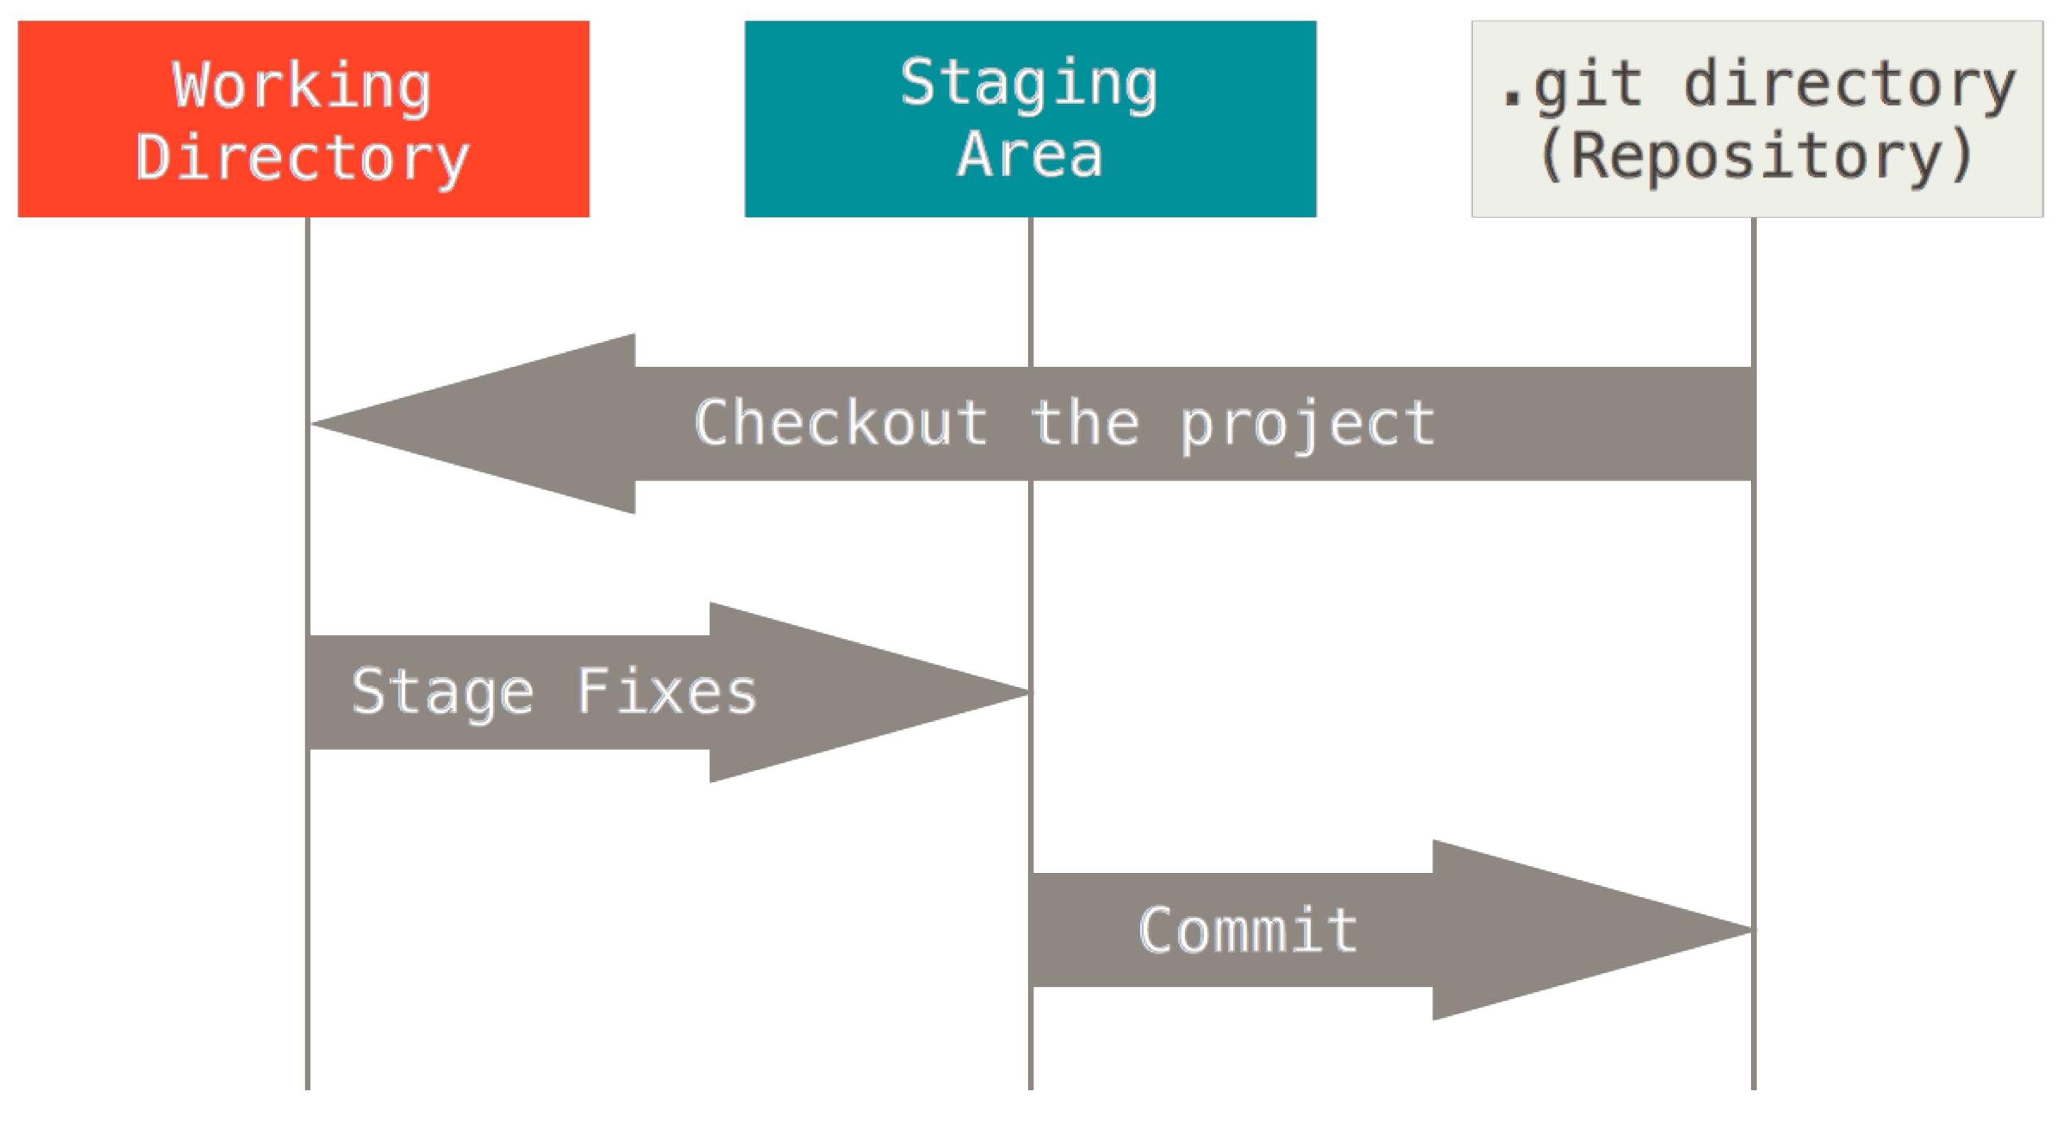
Typical Workflow
git clone, init, checkout
git add
git commit

Slide 34
Client side: commit
Modifies the local repository
Atomic operation
Either succeeds completely, or fails completely
If many Cis are committed and one fails, no CI is committed
The integrity of the repository is assured
It is mandatory to provide a log message (or comment) with the commit
to explain the changes made
the message becomes part of the history of the repository

Slide 35
CIs states
Untracked: in the working folder but not tracked (monitored) by git
Staged (tracked): in WC (or staged area) - add command
Modified
Unmodified
Committed: versioned, in the local repository – commit command
(another option is to explicitely exclude files from version control using the .gitignore file so that such files and folders will not be staged)

Slide 36
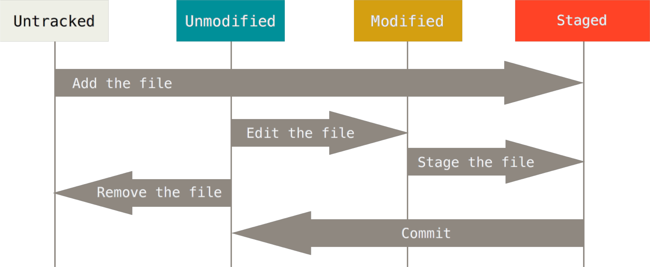
CIs States

Slide 37
Snapshot
Set of all files (CIs) in a repository, in a certain version
Identified by a unique ID (commit hash) computed at commit time
Ex long version 8406cb12bff17d95a92ee0ac704d2dc037fa97
short version 8406cb1
You get id with
git log
git rev-parse HEAD
git rev-parse –short HEAD

Slide 38
Server side
Remote repository, shared by all clients
Push: uploads a snapshot from local repository to remote repository (sync of repositories)
Pull: downloads snapshot from remote repository to local

Slide 39
Summary of commands
Set up user
Config –global user.name «my_name»
Config –global user.email «my_email»
Set up repo
Local
Init : creates a local repo in current folder
Remote
Remote add: connects local repo with remote repo
Work on local repo
Add, rm, mv
Commit
Checkout <hashcode>
Fetch, Rebase
Log, status, diff
Work on remote repo
Push, pull

Slide 40
Commands - set up
git config –global user.name «my_name»
git config –global user.email «my_email»
Define name and email of user – to be done once
git init
Initializes an empty local repository in the current folder
creates a .git directory inside it
git remote add origin http://server.com/project.git
Adds a new remote repository
Origin is the ‘standard’ name for indicating the principal remote

Slide 41
Commands - understand
git status
Show which files are in which state
git diff
Similar to previous, but shows also lines changed
git log
Show history of what happened in a repository
git ls-files
Show tracked files

Slide 42
Commands - modify local repo
git add <file>
add <file> to the WC (<file> changes will be tracked from now on)
git rm <file>
Remove <file> from the WC (changes will not be tracked anymore) and file system
git restore <file>
Restore file in file system
git mv <file>
Rename a file
Git doesn’t explicitly tracks renaming. No metadata is stored in Git that tells it the file was renamed
git commit
Commit changes from WC to local repo
git commit -a
Commits all tracked files, without need to add them to staging area

Slide 43
Basic Concepts: fetch, rebase
Updates the working copy with respect to the repository
Fetch gets changes from the repository
merge such changes with the ones you have made to your working copy, if necessary
checkout

Slide 44
Commands – work with remote repo
git pull
fetch and then merge remote repo on local repo
git push
upload local repo on remote repo

Slide 45
Commands – help
git help <command>
git <command> -help

Slide 46
Example 1
echo "# tmp" >> README.md
git init
git add README.md
git commit –m "first commit"
git remote add origin git@github.com:user/tmp.git
git push –u origin master

Slide 47
Common scenarios
Start a project from scratch. Create local repo, work on it, sync on remote repo
Git init
… work on files file1 file2 filen
Add file1, file2, filen
Commit
Remote add
push

Slide 48
Common scenarios
A project has already been created by others, sync locally, work on it, sync remotely
Git init
Git add remote
Pull
.. Work on files
Add
Commit
Push

Slide 49
Common scenario
Modifying a project, build fails, cant understand why. Retrieve previous version that did build
Git checkout <commit id>
Git checkout –b <new branch> <commit id>

Slide 50
Atomicity
Git commands tend to be focused on one task.
Therefore, what the user perceives as one logical step may require two or three consecutive command calls.
This helps in understanding what you are doing, and when something goes wrong you know where exactly the problem occurred.

Slide 51
Branching

Slide 52
Branching - motivation
Two modes of development in a project
Linear
Branching

Slide 53
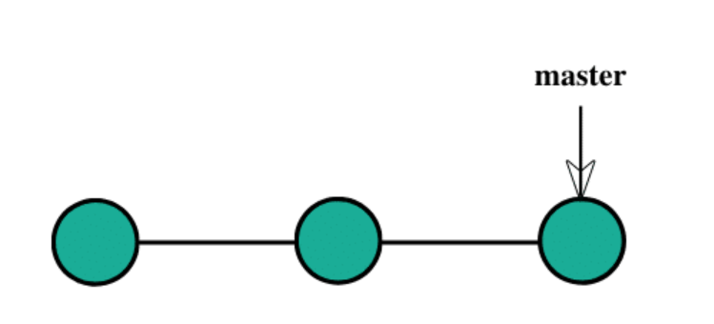
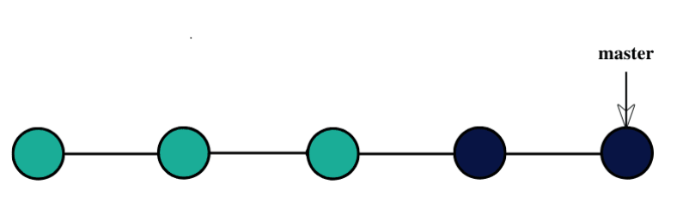
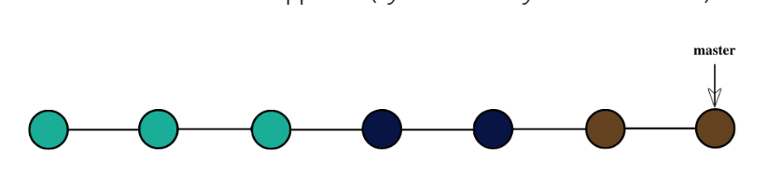
Linear development
Initial status of project
Add feature 1 (blue)
Add feature 2 (brown)

Slide 54
Linear development
For some reason (ex client rejects feature 1, but wants feature 2) the project needs to delete feature 1 and keep feature 2
However, changes are intertwined, doing this will be very difficult

Slide 55
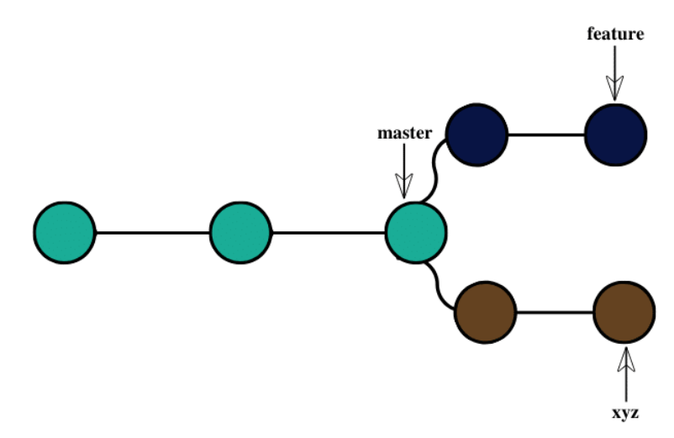
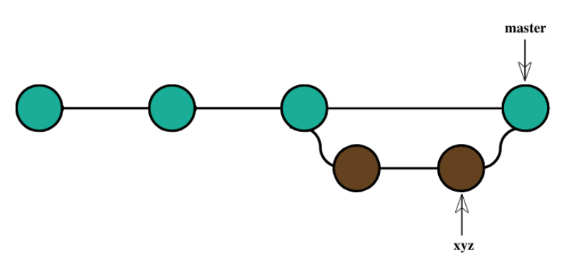
Branching
One branch per feature, master remains unchanged
To cancel blue feature just delete its branch, and merge brown branch into master

Slide 56
Git Branching

Slide 57
Commands
Create a new branch
git branch <new branch>
git checkout -b

Slide 58
Data Storage in Git
Git stores a commit object that contains
a pointer to the snapshot of the content you staged
pointers to the commit or commits that directly came before this commit (its parent or parents)
Staging the files
checksums each one
stores that version of the file (blobs)
adds that checksum to the staging area

Slide 59
Example
Given a directory containing three files, stage them all and commit
Git repository now contains five objects
one blob for the contents of each of the three files
one tree that lists the contents of the directory and specifies which file names are stored as which blobs
one commit with the pointer to that root tree and all the commit metadata

Slide 60
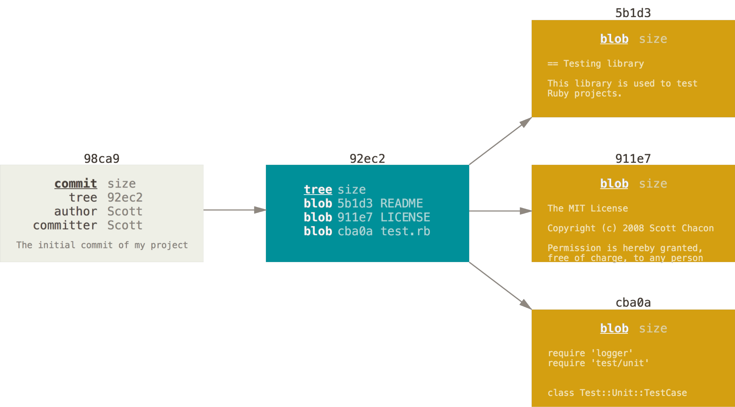
Example

Slide 61
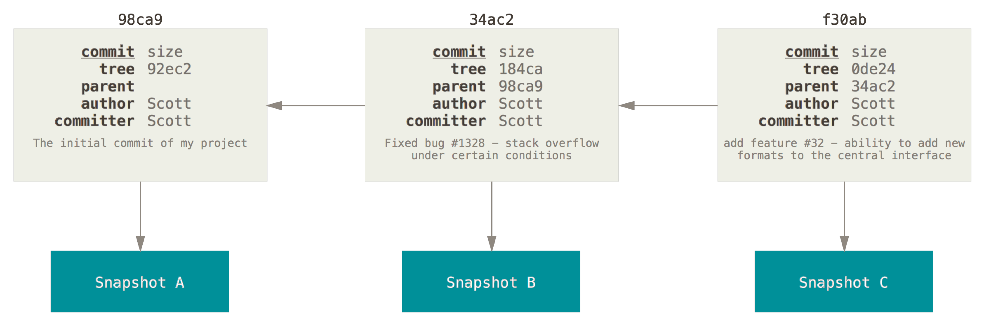
Example
The next commit stores a pointer to the commit that came immediately before it

Slide 62
Branches
A branch in Git is simply a lightweight movable pointer to one of these commits
Git branch <name> // creates a branch, ie creates a pointer
HEAD points to the current branch
The default branch name in Git is master
Every commit, HEAD moves forward automatically
HEAD can be moved in other ways too
Git checkout <name> // HEAD now points to <name>
Git checkout –b <new branch> <commit id> // creates branch and moves HEAD

Slide 63
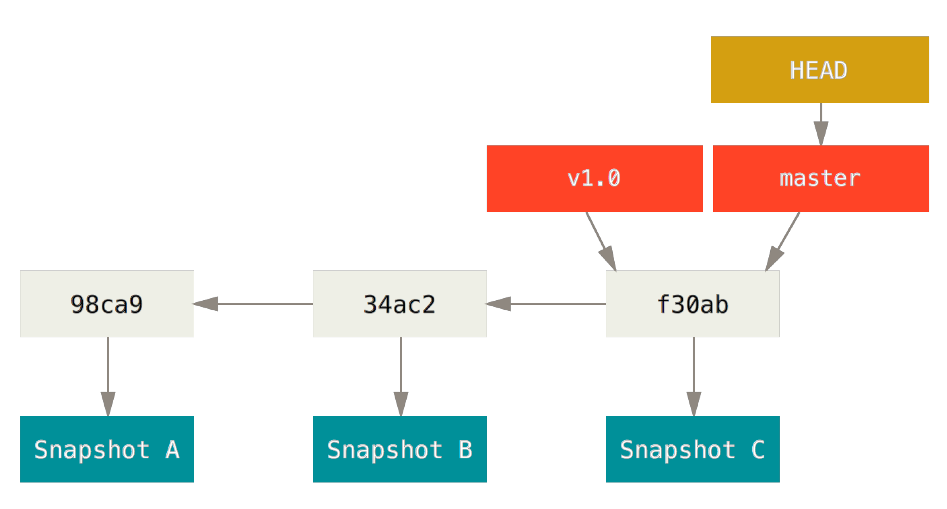
Branches

Slide 64
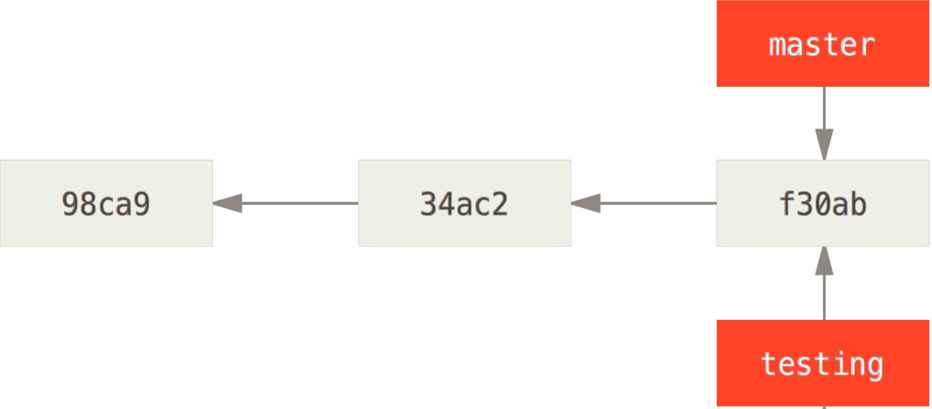
Creating a Branch
git branch testing
Create a branch named testing
Git still not switches to that branch

Slide 65
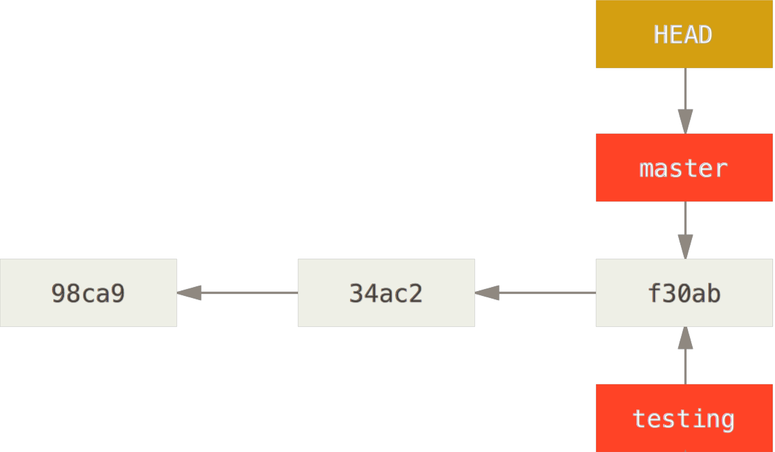
Head Pointer
Pointer to the current local branch

Slide 66
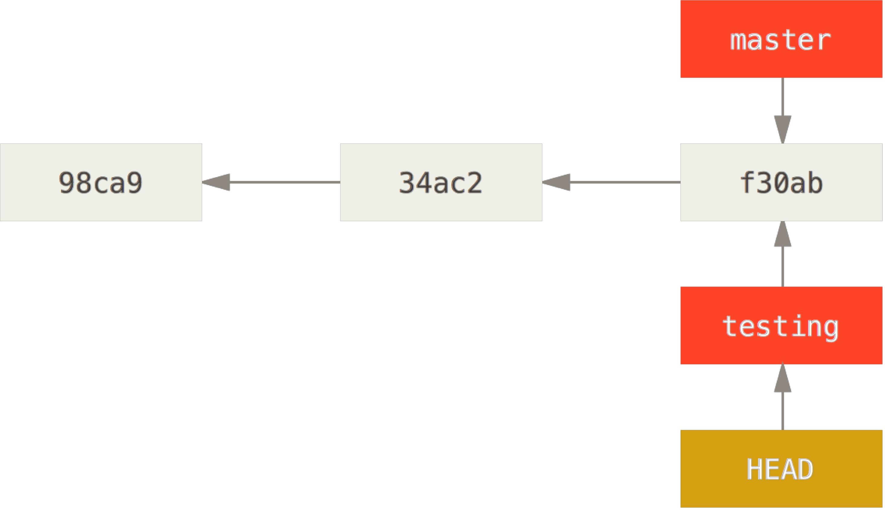
Switching Branches
git checkout testing

Slide 67
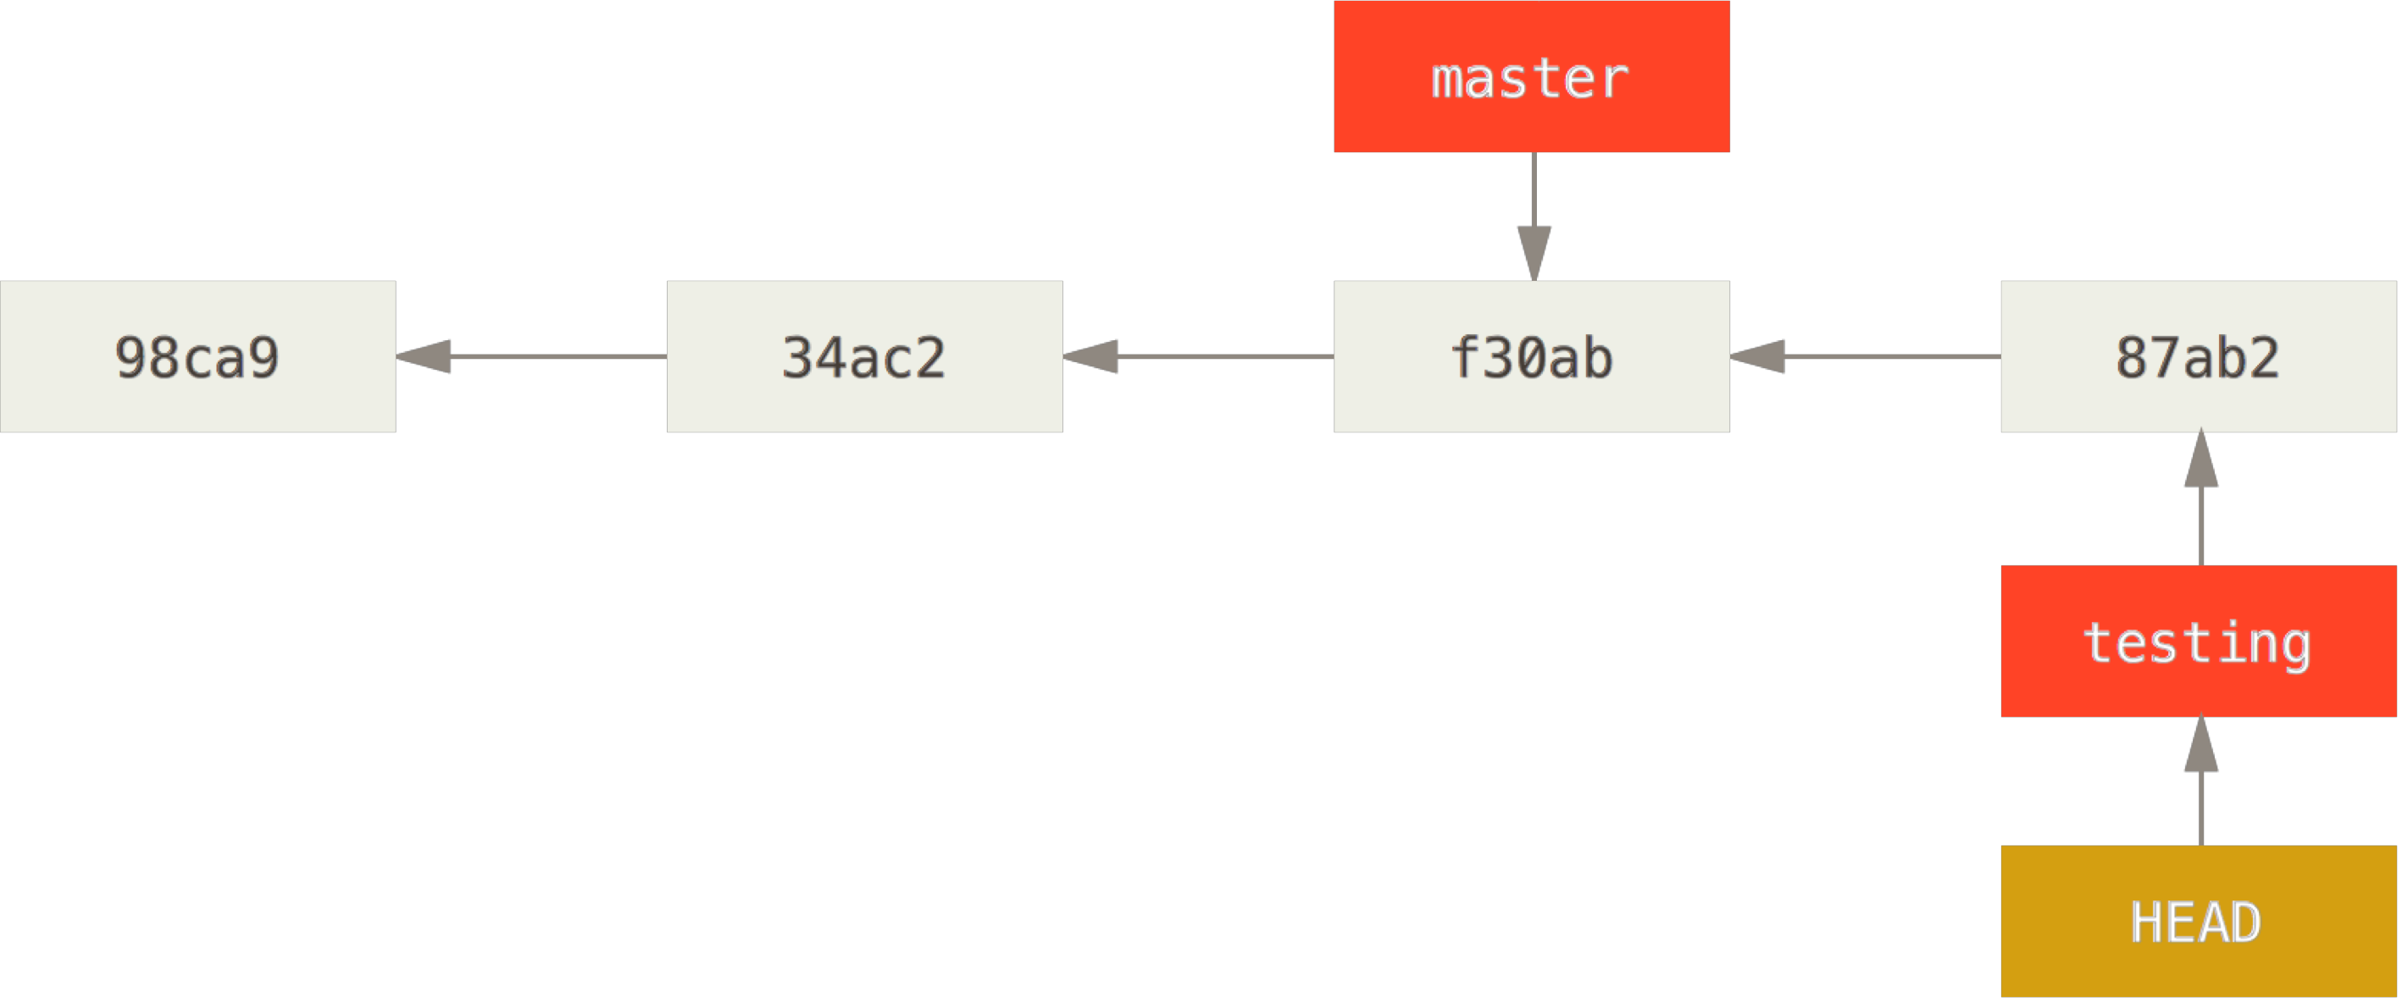
Switching Branches
After another commit

Slide 68
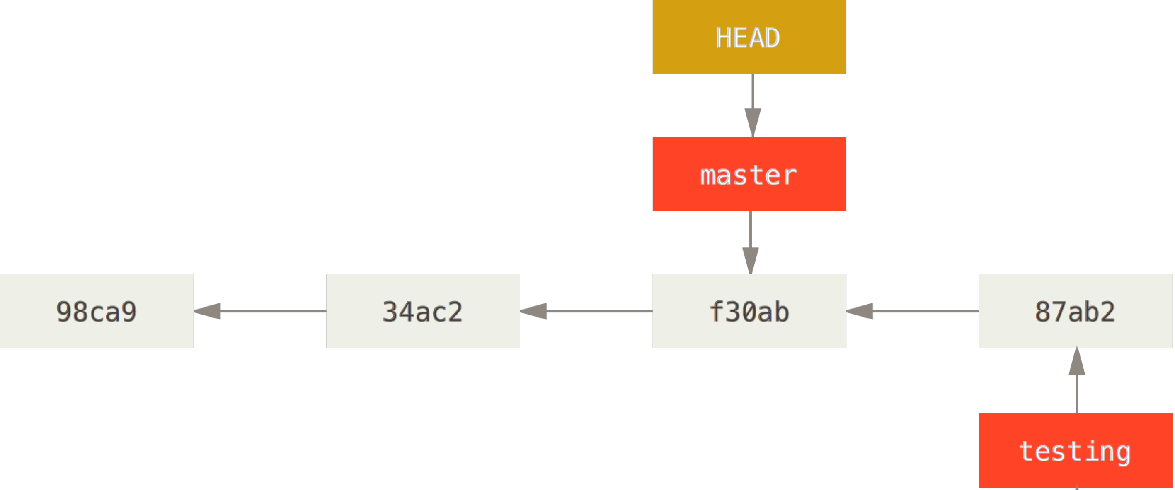
Switching Branches
git checkout master
Not only moves HEAD, also switches WC (files in .git folder now are the files of snapshot f30ab)

Slide 69
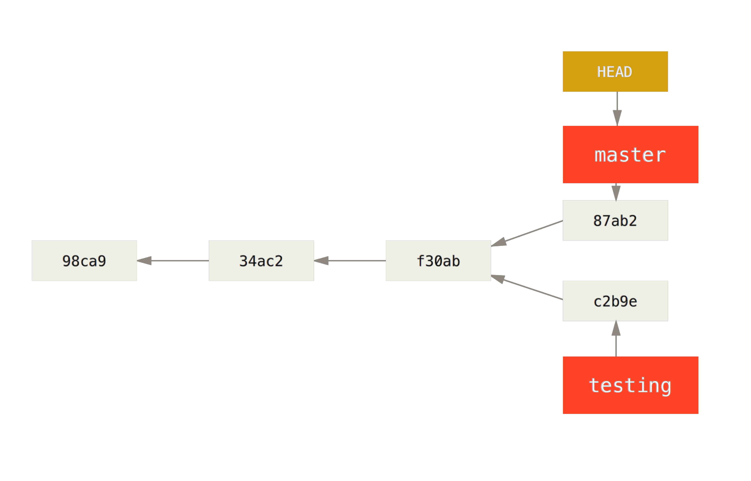
Switching Branches
git commit
commits from this point on will diverge (‘divergent history’)

Slide 70
Switching – git log
Git log
Will show only one flow of commits (master)
Git log testing
Will show flow of commits for ‘testing’ branch
Git log –all
Will show all flows

Slide 71
Merging branches
Without divergent history
With divergent history

Slide 72
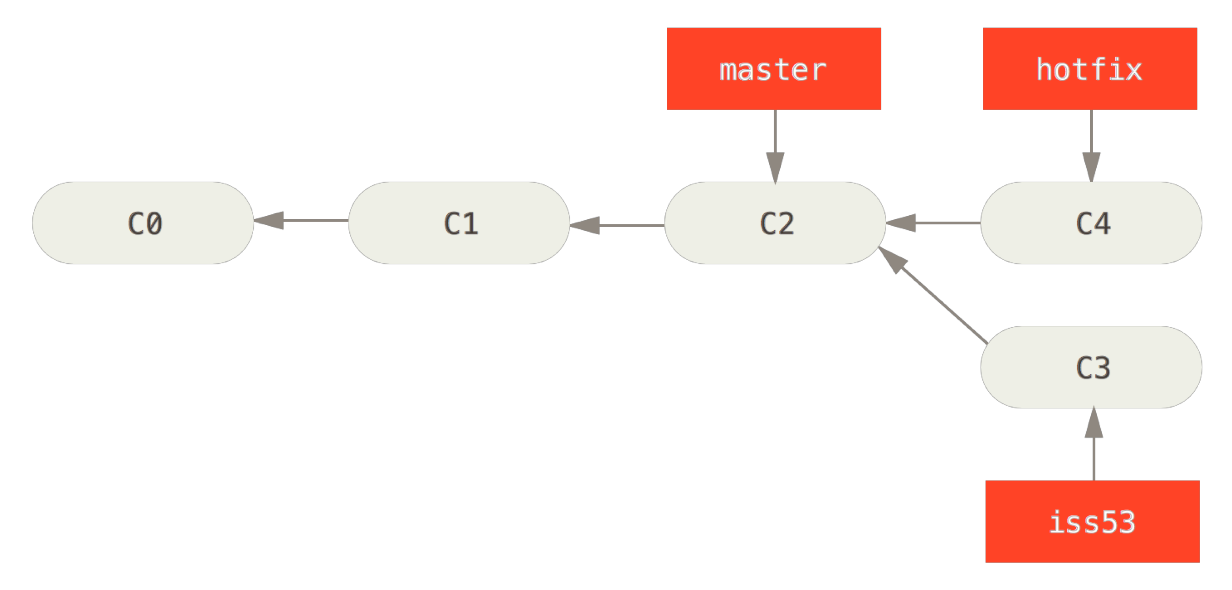
Merging Branches – no divergence
Initial situation (HEAD → hotfix)
Notes:
Context. Current release is master. Then work on upgrade on iss53, to be released later. However, bug on master discovered. Go back on master, change to fix, create hotfix. Test hotfix. When ready can upgrade master to hotfix (master includes the changes of hotfix)

Slide 73
Merging Branches – no divergence
Merging hotfix with master:
git merge hotfix

Slide 74
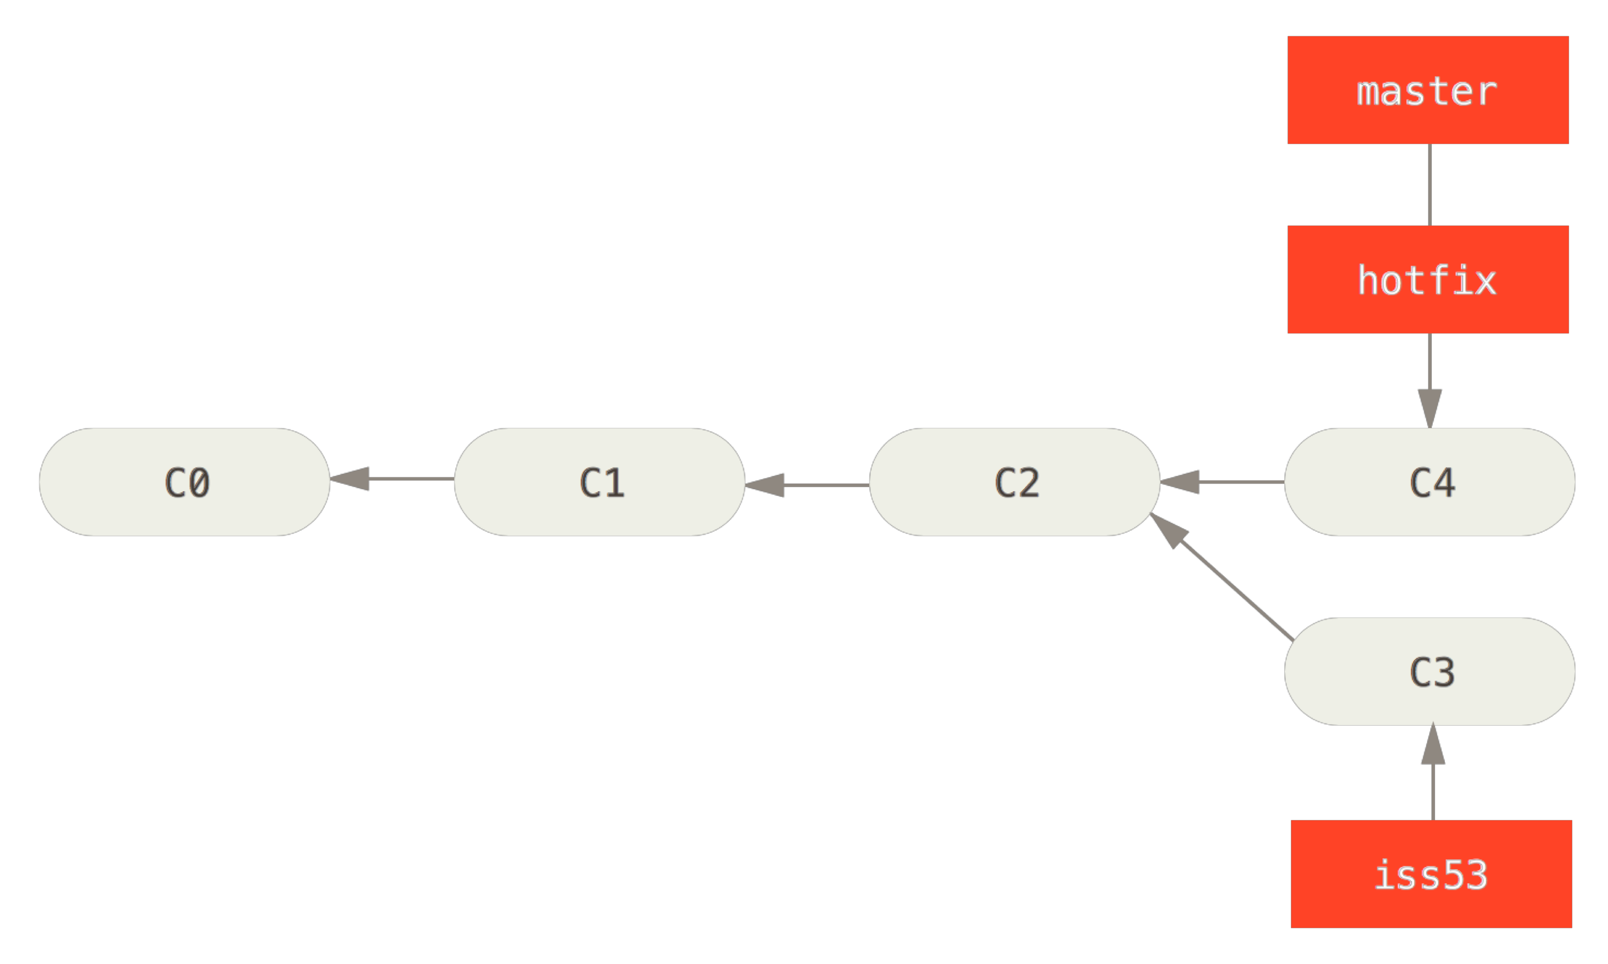
Merging Branches – no divergence
Master and hotfix are merged, hotfix can be deleted
git branch –d hotfix
Notes:
No divergence, merge means just working with HEAD
After that, hotfix can be deleted git branch – d hotfix

Slide 75
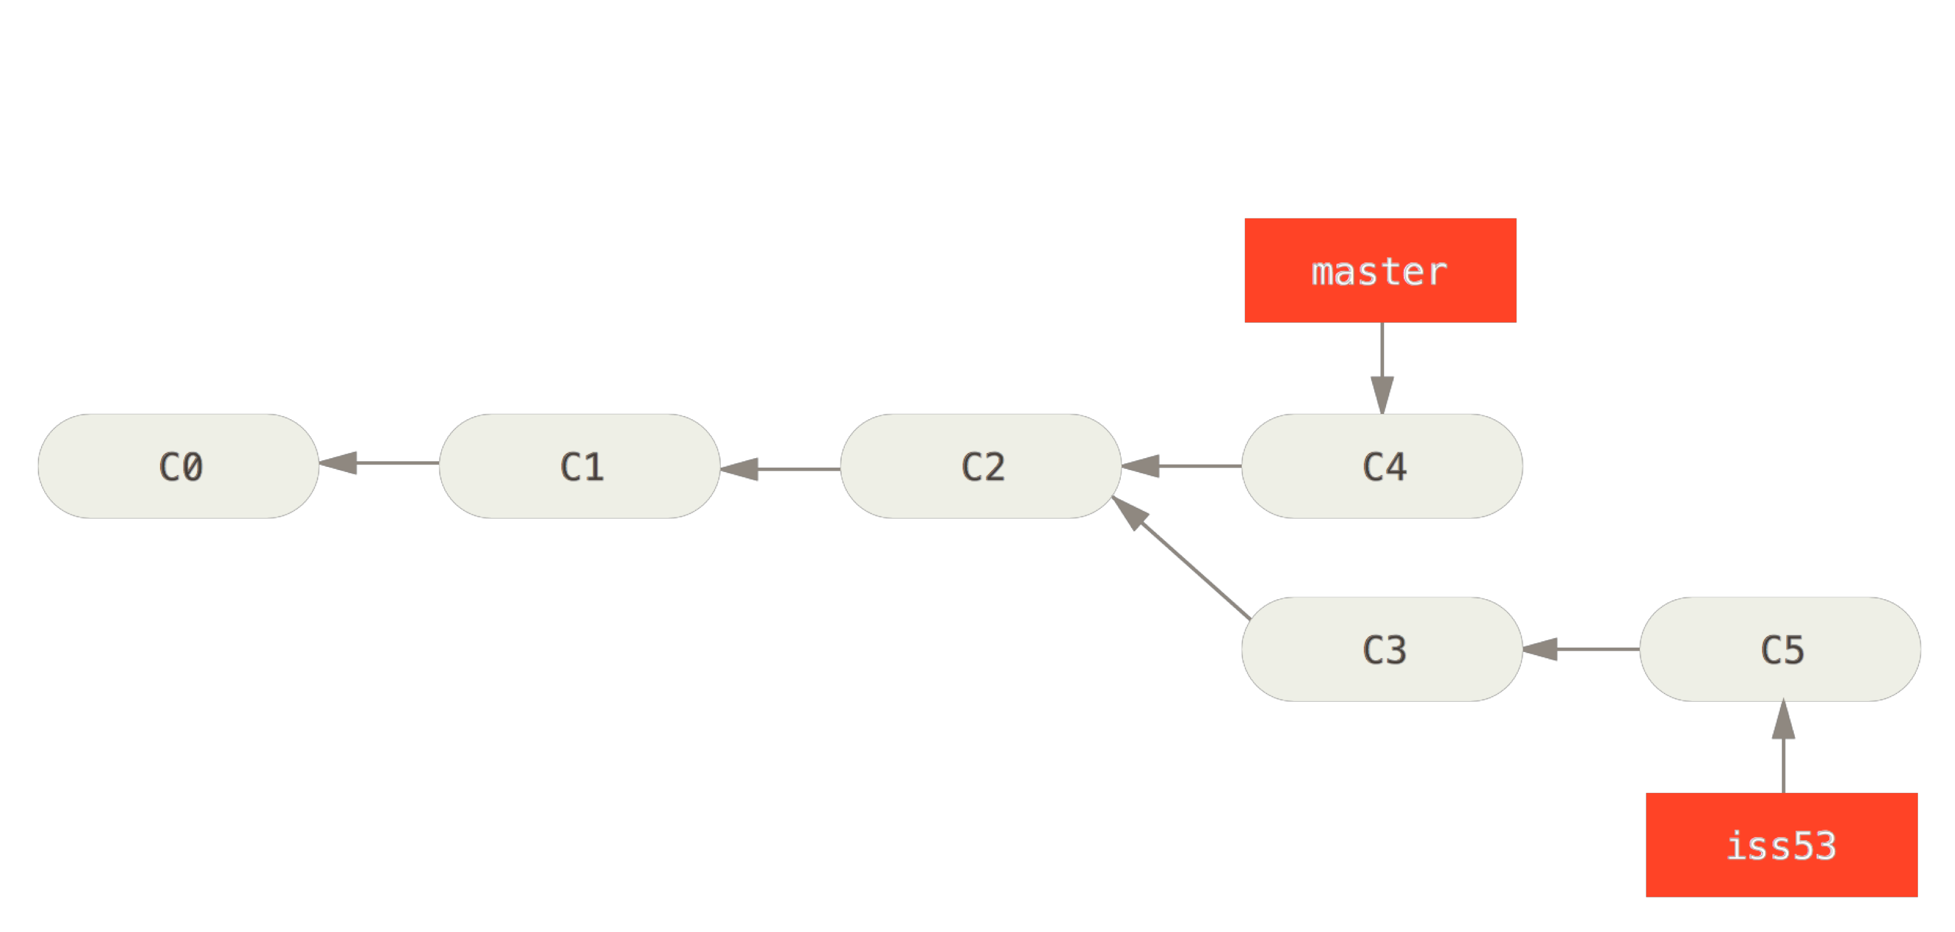
Merging Branches – with divergence
New commit on iss53
Notes:
Now work resumes on iss53, and proceeds with various commits

Slide 76
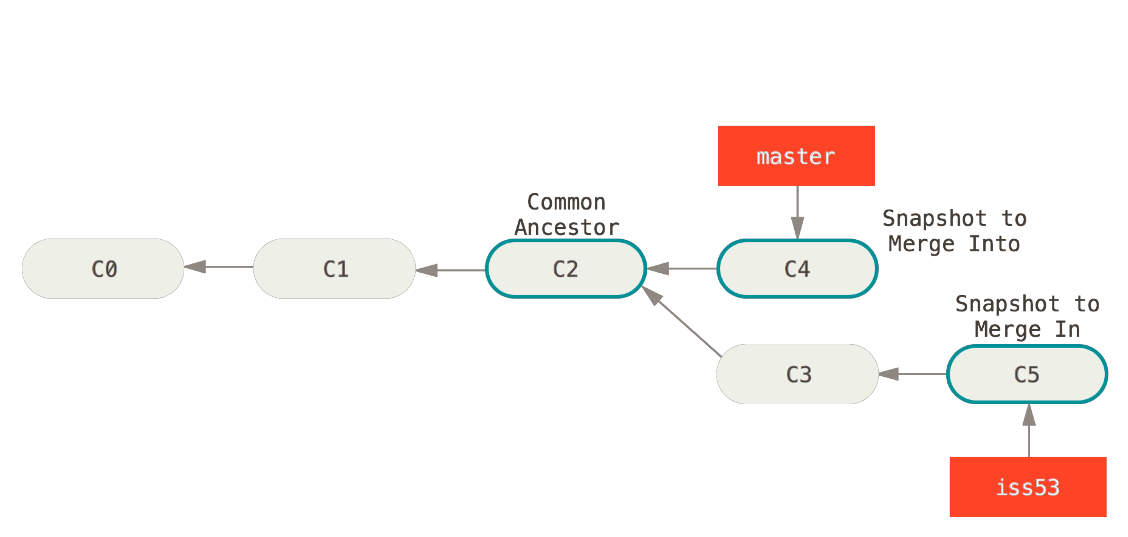
Merging Branches – with divergence
git checkout master
git merge iss53
Notes:
Now iss53 is complete (tested etc). Want to merge with master. This master different (c3, C5 do not include the hotfix)

Slide 77
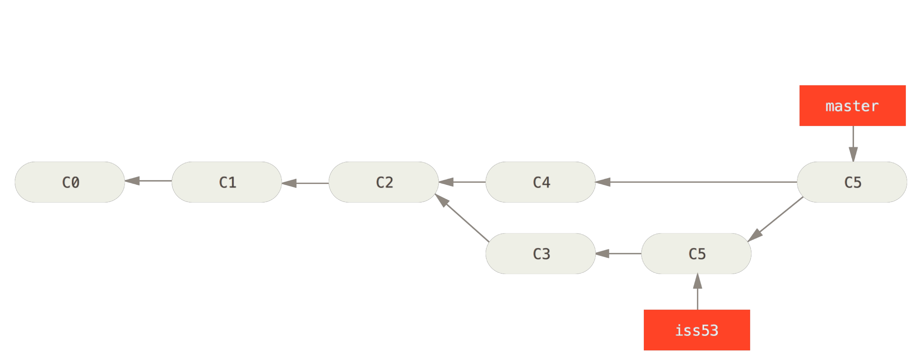
Merging Branches – with divergence
Final result:
Notes:
Creato nuovo snapshot

Slide 78
Merging Branches – with divergence
Instead of just moving the branch pointer forward, Git creates a new snapshot that results from this three-way merge and automatically creates a new commit that points to it
Three way: C4, C5, C2 (common ancestor)
This is referred to as a merge commit, and is special in that it has more than one parent
Git determines the best common ancestor to use for its merge base

Slide 79
Merging - conflicts
Conflicts are possible,
Ex same file modified in same part in C4 and C5
in this case merging is not done until conflicts are managed
git mergetool
Helps in managing conflicts

Slide 80
Rebase
Another way of merging
Rebase applies changes of one snapshot history to another

Slide 81
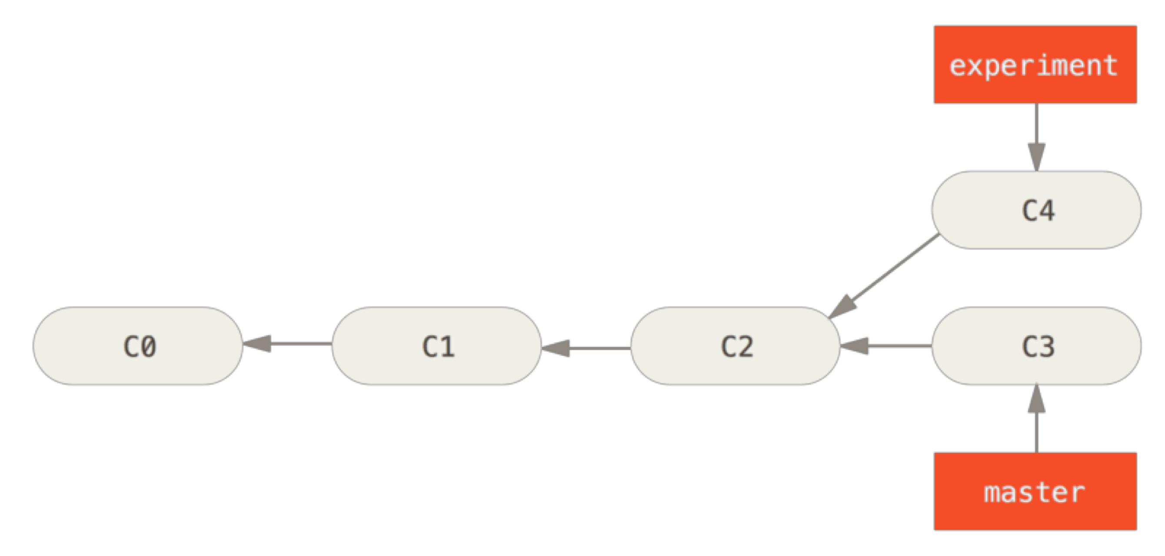
Starting point
Notes:
The starting point

Slide 82
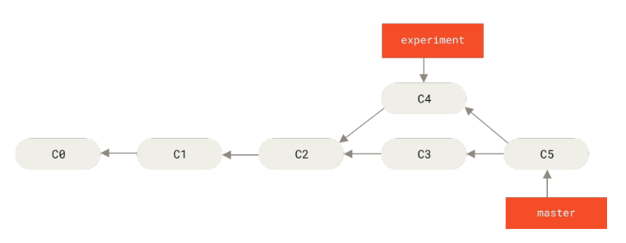
Result
git checkout master
git merge experiment

Slide 83
Rebase
git checkout experiment
git rebase master
Notes:
Instead of applying git merge, rebase reapplies the changes

Slide 84
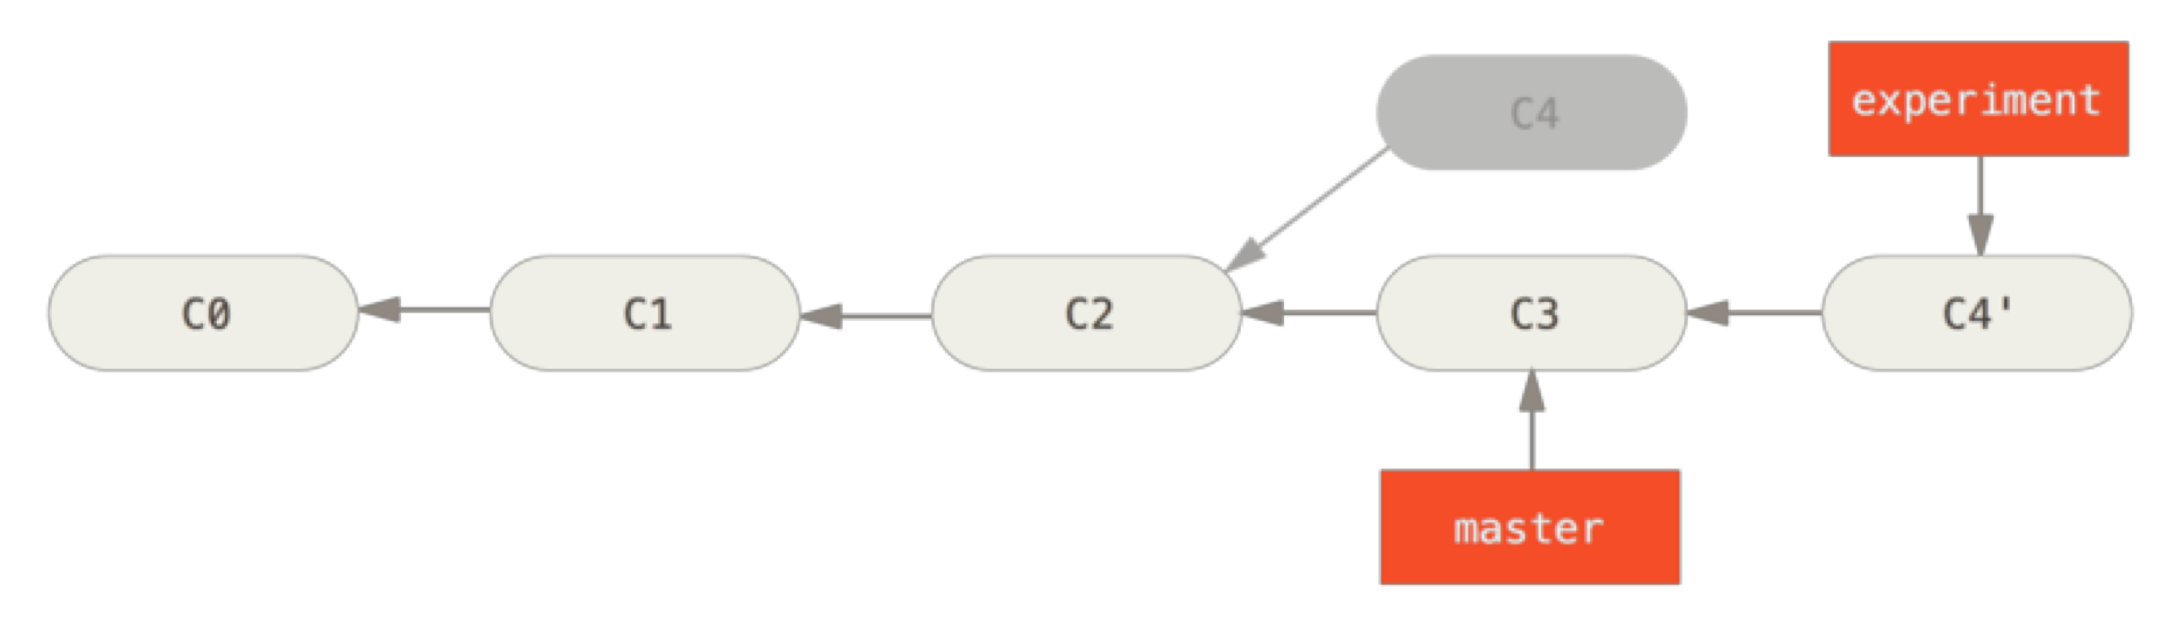
Rebase
git checkout master
git merge experiment
Notes:
Reapplied changes of experiment (C4) to C3, produce C4’

Slide 85
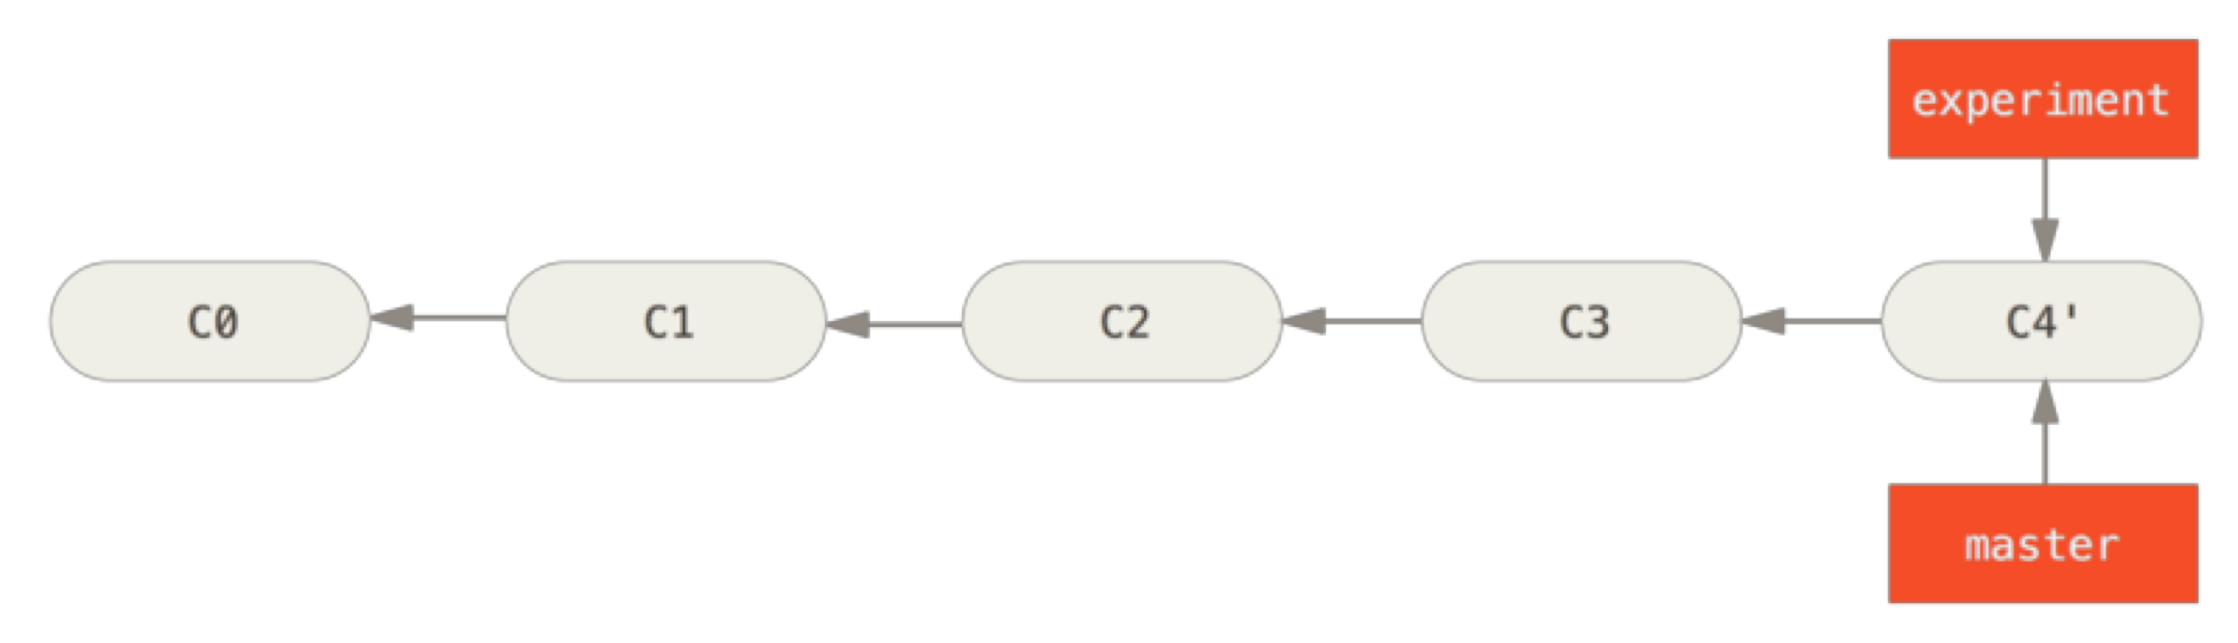
Rebase
Result
Be careful, rebase rewrites the repository history!

Slide 86
Rebase
It is also possible to organize/edit your commits
Some useful cases:
the commit message is wrong, or it does not make sense.
the order of the commits is not nice regarding to git history.
there are more than one commit which make similar changes (or even the same thing).
a commit grouped a lot of different code, and it makes sense divide it in smaller commits.

Slide 87
Rebase
git rebase -i HEAD~4
-i => interactive mode
~4 =>number of commits we want to target.

Slide 88
Changing Commit Order with Rebase
git rebase -i HEAD~4
pick 0a0cf97 document
pick d09e470 add paragraph
pick 59b2309 add second document
pick 16013c6 change title
Change the order of these lines (cut and paste)

Slide 89
Changing Commit Order with Rebase
git rebase -i HEAD~4
pick 0a0cf97 document
pick 59b2309 add second document
pick d09e470 add paragraph
pick 16013c6 change title

Slide 90
Edit Commit Messages
git rebase -i HEAD~4
pick 0a0cf97 document
pick 59b2309 add second document
reword d09e470 add paragraph
pick 16013c6 change title
Change pick with reword for editing the commit message

Slide 91
Merge Commits
git rebase -i HEAD~4
pick 0a0cf97 document
squash 59b2309 add second document
pick d09e470 add paragraph
pick 16013c6 change title
Change pick with squash for merging the second commit with the first

Slide 92
Merge Commits
The result will be:
# This is a combination of 2 commits. # The first commit's message is:
document
# This is the 2nd commit message:
add second document
# Please enter the commit message for your changes.
Delete all this lines and write a message for the new commit

Slide 93
Rebase vs. Merge
The main differences between rebase and merge are:
merge combines the commit history of two branches, while rebase creates a linear commit history.
merge creates a new merge commit, while rebase rewrites the commit history of the feature branch.
merge is better suited for integrating changes from different branches, while rebase is better suited for keeping a cleaner commit history.

Slide 94
Rebase vs. Merge
merge is generally considered safer than rebase because it preserves the original commit history and creates a new merge commit, which makes it easier to undo the merge if necessary.
Graph structure: Every merge commit increases the connectivity of the commit graph by one. A rebase, by contrast, does not change the connectivity and leads to a more linear history

Slide 95
Models for Collaborative Development
People collaborate on GIT in two ways:
Shared repository
Fork and pull

Slide 96
Shared Repository
With a shared repository, individuals and teams are explicitly designated as contributors with read, write, or administrator access.
This simple permission structure, combined with features like protected branches and Marketplace, helps teams progress quickly when they adopt GitHub.

Slide 97
Fork and Pull
For projects to which anyone can contribute, managing individual permissions can be challenging, but a fork and pull model allows anyone who can view the project to contribute.
A fork is a copy of a project under a developer’s personal account.
Every developer has full control of their fork and is free to implement a fix or new feature.
Work completed in forks is either kept separate or is surfaced back to the original project via a pull request.

Slide 98
Fork
A fork is a copy of a repository that a developer manages.
Forks let the developer make changes to a project without affecting the original repository.
The developer can fetch updates from or submit changes to the original repository with pull (or merge) requests.

Slide 99
Pull (GitHub) or Merge (GitLab) requests
Pull requests let the developer tell others about changes he or she has pushed to a branch in a repository on git.
Once a pull (or merge) request is opened, the developer can discuss and review the potential changes with collaborators and add follow-up commits before your changes are merged into the base branch.

Slide 100
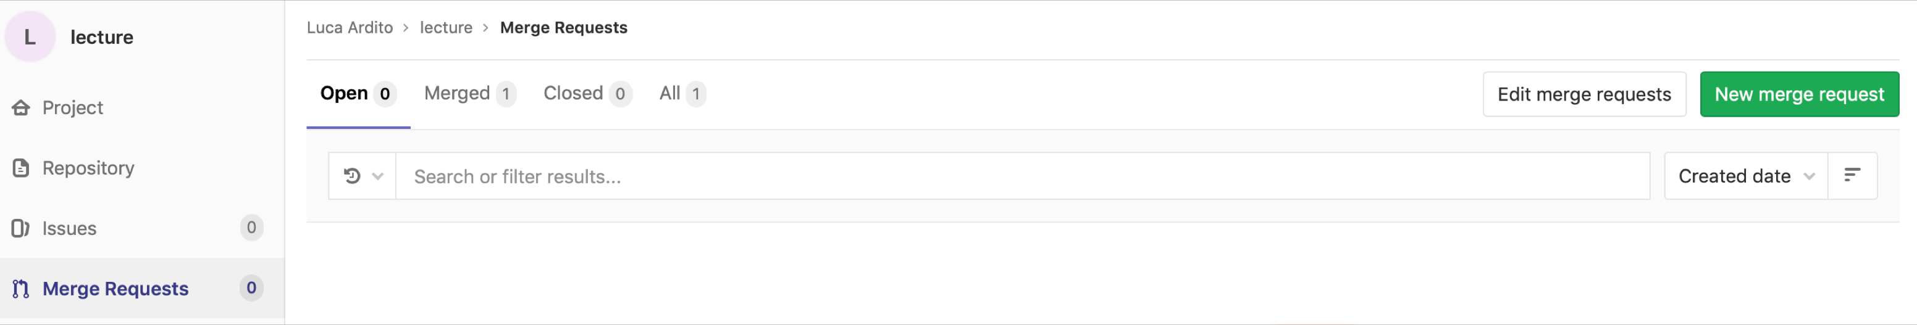
Merge Requests
Create a new branch
Work on the new branch
Commit and push your work
Open the project on Gitlab and create a new merge request

Slide 101
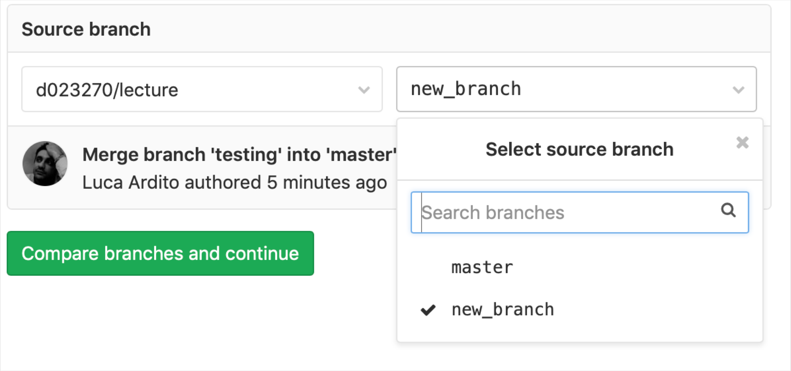
Merge Requests

Slide 102
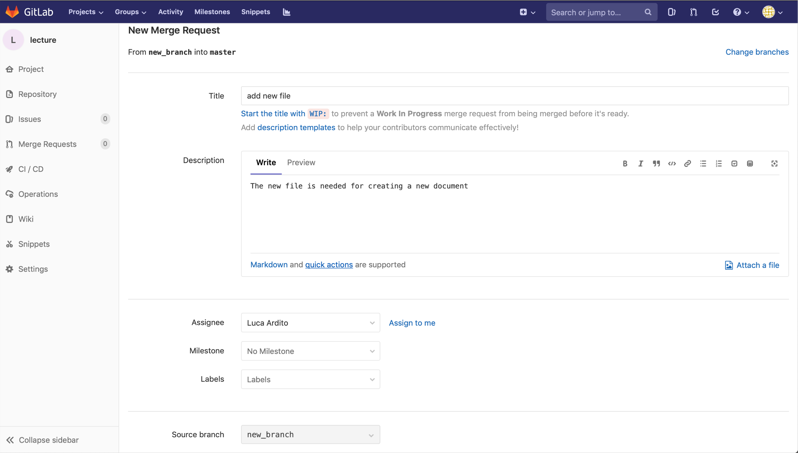
Merge Requests

Slide 103
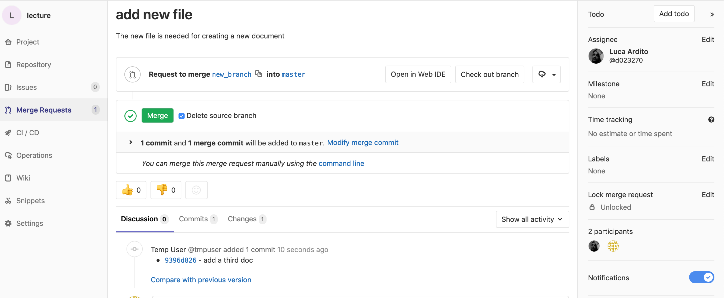
Merge Requests

Slide 104
What to do when you think you are lost
DON’T PANIC!
git reflog is your friend!

Slide 105
What to do when you think you are lost
Git will try to preserve your changes.
Uncommitted changes to git-controlled-files will only get overwritten if running one of the commands:
git checkout <file-or-directory>
git reset --hard
And of course any non-git commands that change files
Files unknown to Git will only get lost with:
git clean
any non-git commands that change files

Slide 106
Conventional Commits
Lightweight convention on top of commit messages
Provides an easy set of rules for creating an explicit commit history
feat: allow provided config object to extend other configs
feat!: send an email to the customer when a product is shipped
BREAKING CHANGE: `extends` key in config file is now used for extending other config files
https://www.conventionalcommits.org/en/v1.0.0/#specification

Slide 107
Recorded Examples
https://www.youtube.com/watch?v=UMcXoJbBGRI

Slide 108
How to use git in project
Each team has a repo
‘Main’ branch, ‘branch’
Team works in ‘branch’
Deliveries are made via merge requests vs ‘main’
To be accepted by teachers
main
merge request
branch
-Team specific
-Cannot be modified
-Used for communication with teachers
-Team specific
-Can be modified
-Used for working

Slide 109
Rules
No changes to main
Project deliveries must refer to one branch only
If you define many branches below ‘branch’ merge them before doing merge request

Slide 110
How to use git
Options in your branch
Do other branches
Per person
Per task
No other branches
main
branch

Slide 111
How to use git
Branching should be used wisely
Need to merge at reasonable intervals to check consistency
Suggestions
Single documents (ex requirements): no branches, all team members work on same file
Group of related files (ex .js files of code part, test part, GUI prototype):
Either no branches, each member works on a different file
Or, branch for each team member, then merge the branches

Slide 112
Git Additional Resources
Reference guide
http://git-scm.com/doc
Book
https://git-scm.com/book/en/v2
GUI tools for git
https://git-scm.com/downloads/guis

